Slide 1
Separating Mixtures
Year 7 Science

Slide 2

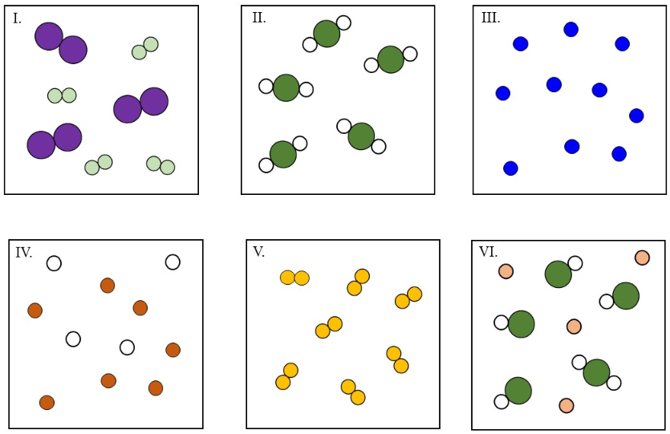
Review: Pure or mixture?

Slide 3
Learning Intentions
Mixtures, including solutions, contain a combination of pure substances that can be separated using a range of techniques.

Slide 4
Success criteria
List ways of separating insoluble substances and identify the property used.
Explain filtration.
Correctly set up filtration equipment.

Slide 5
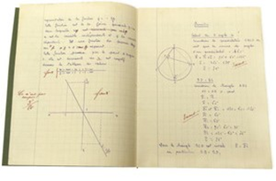
Separating insoluble mixtures 13/05/2024
Technique | Property

Slide 6
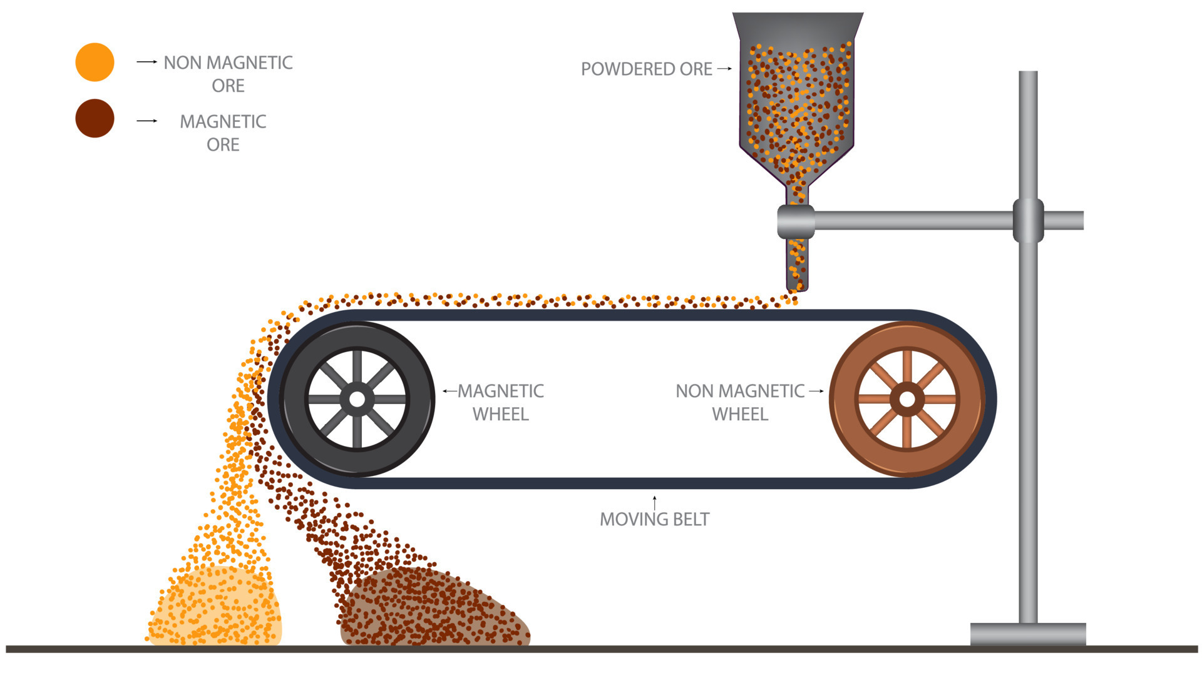
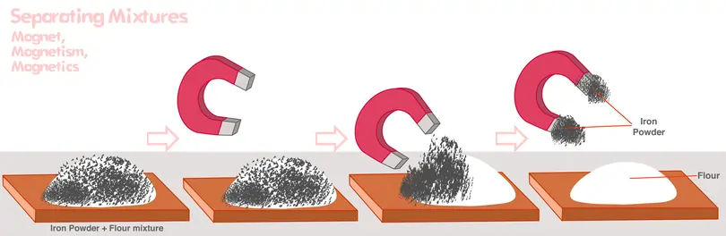
Magnetic

Slide 7
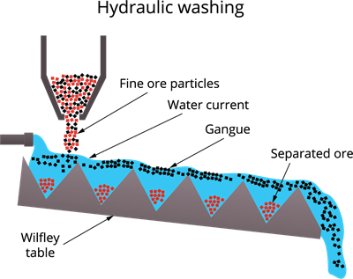
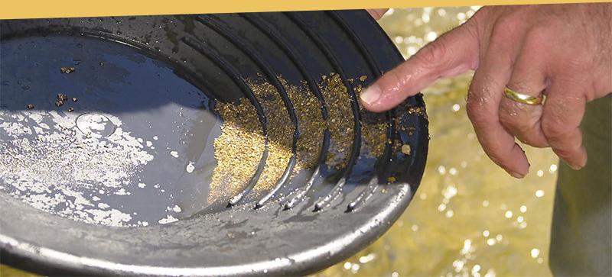
Gravity

Slide 8
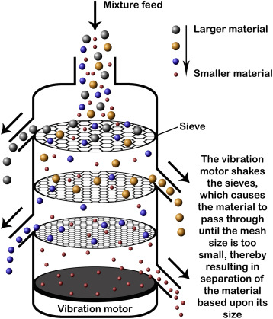
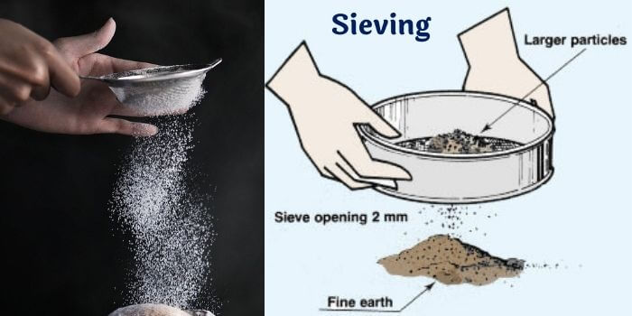
Sieving

Slide 9
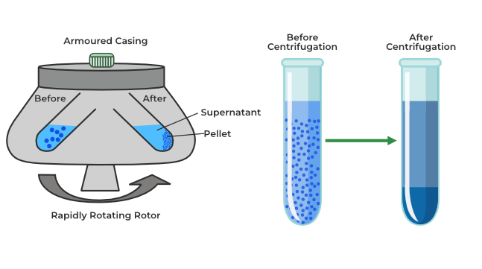

Centrifuge

Slide 10
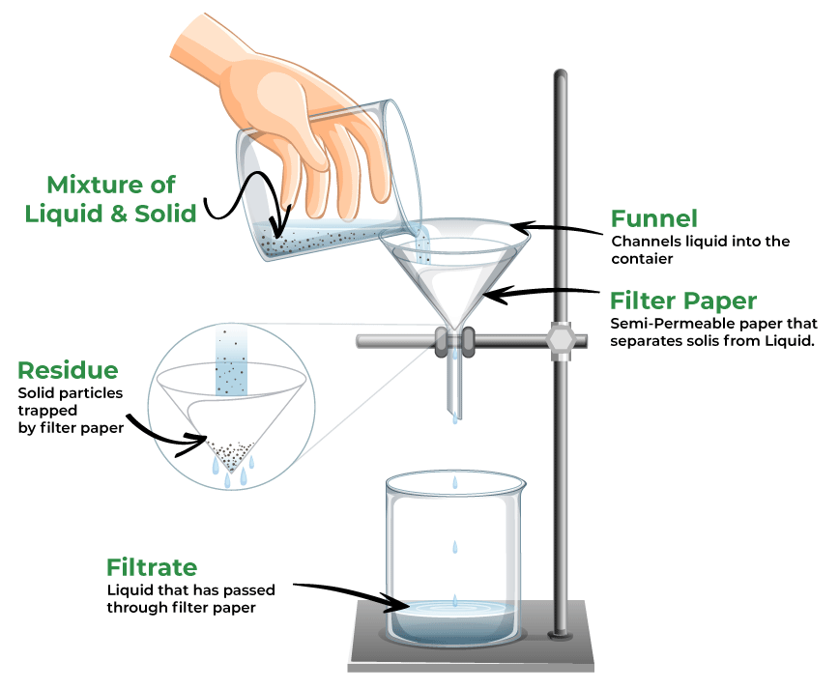
Filtration

Slide 11
Success criteria
List ways of separating insoluble substances and identify the property used.
Explain filtration.
Correctly set up filtration equipment.

